Slide 1












Heritage Fair Project Lessons
Research Guide
Part One
By Faith Boser

Slide 2

Choosing a topic for your heritage fair project
1
Look through the Heritage Fairs website - are there any topics listed that you are interested in?
Look through photos of projects on the website from previous years to give you ideas.
Think about topics related to Canada that interest you.
Notes:
If you don’t know what topic to do for your Heritage Fair project, look through the Heritage Fairs website – are there any topics listed that you are interested in?
If you still aren’t sure, there are photos of many different projects students have done in the past. Maybe one of these will inspire you!
If you still aren’t sure; think about what topics related to Canada that interest you. This could be something that happened a long time ago, or more recently; it could be someone who lived a long time ago or is living today. The options are endless.

Slide 3
Narrowing down your topic
2
For example, you are interested in doing your project on World War II.
Pick a specific event that Canada was involved in to focus on, such as:
The Dieppe Raid
D-Day
The Battle of Normandy
It’s okay if your topic changes as you do more research.
A topic that is too broad will be more difficult to cover in a short presentation.
Notes:
A topic that is too broad will be more difficult because it will be harder to cram all the information in a short presentation. It is best to choose a more focused topic.
For example, you are interested in doing your project on World War II.
Pick a specific event that Canada was involved in to focus on, such as:
The Dieppe Raid
D-Day
The Battle of Normandy
It’s okay if your topic changes as you do more research.
Make sure you still choose something that you can find enough information on. If you need help with this, ask your teacher.

Slide 4
Once you have chosen your topic, it’s time to get started on your research
3
Look through the Heritage Fairs website - are there any links or books listed related to your topic?
Go to a search engine like Google and search your topic.
Go to your school or local library and look for books on the topic.
Notes:
First, look through the Heritage Fairs website - are there any links or books listed related to your topic?
Next, go to a search engine like Google and search your topic.
You can also go to your school or local community library and look for books on the topic.

Slide 5
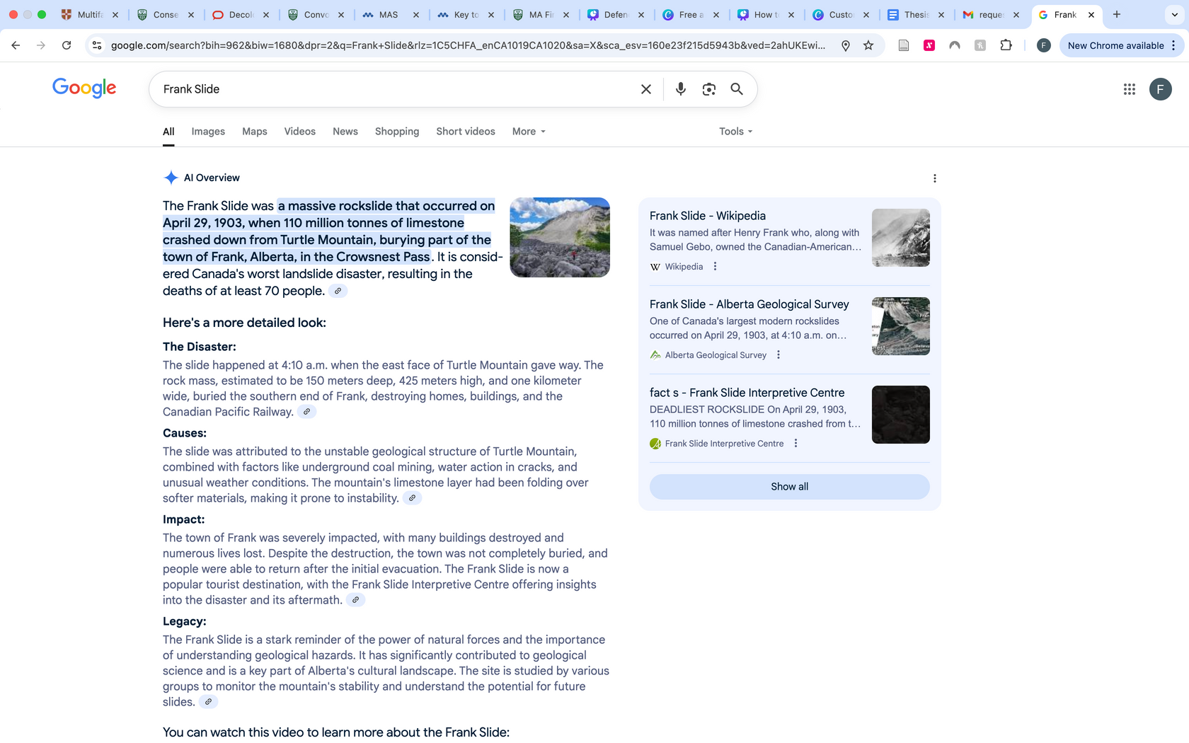

If you choose to use a search engine like Google, make sure you choose credible sources
4
A source that provides you with accurate information that you can trust
What is a credible source?
Notes:
If you choose to use a search engine like Google, make sure you choose credible sources. What is a credible source? It is a source that provides you with accurate information that you can trust. There are lots of sources online that include false or inaccurate information. There is a feature on Google, which gives you an AI overview when searching a topic. For example, when you google "Frank Slide," the AI overview will pop up at the top of the page, which summarizes information pulled by the AI from different websites on the internet. The AI overview is not a reputable source on its own. It can provide you with quick information to help with your search, but you must hunt down sources on your own.

Slide 6
Identifying credible and trustworthy online sources
5
Look at who created the source - use ones created by trusted authors such as:
The Government of Canada, universities, and museums.
The Canadian Encyclopedia
SaskToday or national news, such as CTV or CBC.
If you are unsure if the source is trustworthy, it is best to use a different source instead.
What do you look for?
Notes:
What do you look for?
Look at who created the source. Make sure to use ones that have been created by trusted authors such as museums, universities, and governments like the Government of Canada or an Indigenous government. Or Encyclopedias like the Canadian Encyclopedia. Local news networks like Sasktoday, or national news like CTV or CBC.
The types of sources you use will depend on how much information has been published on your topic.
If you are unsure if the source is trustworthy, it is best to ask your teacher for help or try using a different source instead.

Slide 7
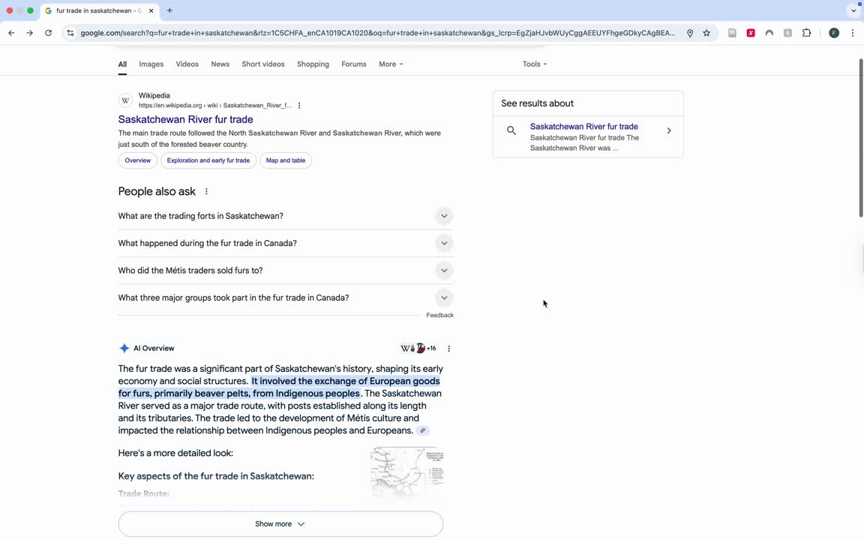
Identifying credible and trustworthy online sources
6
What do you look for?
Notes:
For example, in the video on the slide, I searched fur trade in Saskatchewan. Scrolling past the AI overview I found a good source from the Encyclopedia of Saskatchewan, scrolling further, I found other good sources from the Province of Manitoba, the Indigenous Peoples Atlas of Canada, and the Canadian Encyclopedia.

Slide 8
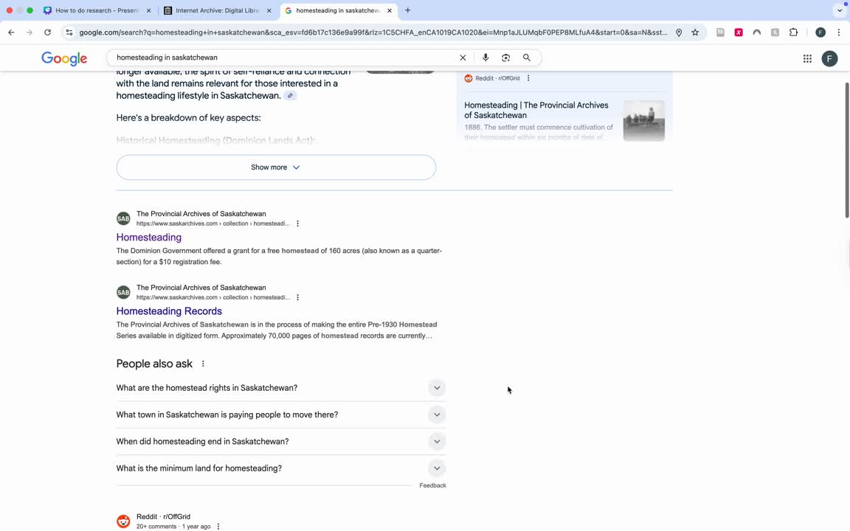
What types of sources are not trustworthy?
7
What do you look for?
Notes:
For instance, if you want to learn about homesteading in Saskatchewan and you search it on Google, you will encounter links to sources that are not trustworthy. In this case it links to questions about modern homesteading on the website Reddit pop up. For one, this source is not about historic homesteading like I want to learn about, and two, it is on a website where anyone can post information, meaning it does not come from credible and trustworthy authors. There are other sources that come up from Facebook, blogs, and other websites that contain information about homesteading that does not relate to what I am researching. For this project topic, these sources should be avoided. There are instances where these sources could be useful depending on what your topic is on. For example, if you are doing your project on a local politician, local business or celebrity, you could use their facebook page as a source. If you are unsure about this, ask your teacher, and if the teacher is unsure, they can contact the Heritage Fairs Coordinator.

Slide 9
What types of sources are not trustworthy?
8
Look at who created the source
Don’t use links to social media sites like Reddit or Facebook, or personal blogs
Is the source helpful for teaching you about the topic?
Some of the sources may be about related topics, such as modern homesteading, instead of historic homesteading
Some sources may provide incorrect information
What do you look for?
Notes:
When trying to identify if a source is trustworthy or not, begin by looking at who created the source. Like I said before, don’t use links to social media sites like Reddit or Facebook, or personal blogs since they contain information that may not be reliable. Personal blogs can be helpful in some cases if you are doing a topic that requires personal perspectives, but it is best to run these by your teacher first.
Next think about if this source is helpful for teaching you about your research topic? For example, when I was searching for information on homesteading in Saskatchewan, a bunch of sources that were unrelated to historic homesteading came up. Be weary of this. If the information seems to be wildly different than you find on trusted websites, then this source shouldn’t be used.
Now that you know how to identify if a source is trustworthy, you are ready to get started on your research! Visit part two of this lesson to learn how to get started.

