Slide 1












Heritage Fair Project Lessons
Research Guide
Part Two
By Faith Boser

Slide 2

Now you’re ready to do some research!
9
  Take notes on the sources you find
    What is the title of the source?
    What year was it published?
    Who is the author?
    Where did you find the source, or who published the source?
    If it's a website, when did you access the resource?
    What information did you learn from the source?
What’s next?
Notes:
Welcome to part two of this research lesson!
What’s next?
Now that you know how to identify reliable sources, try it out for yourself.
As you research, take notes on the sources you find.
What is the title of the source?
What year was it published?
Who is the author?
Where did you find the source (not google, but the URL or address of the website), or who published the source?
If it is a website, when did you access the resource?
Finally, take notes on the information you learned from the source so you can put it in your own words and incorporate it into your project.

Slide 3
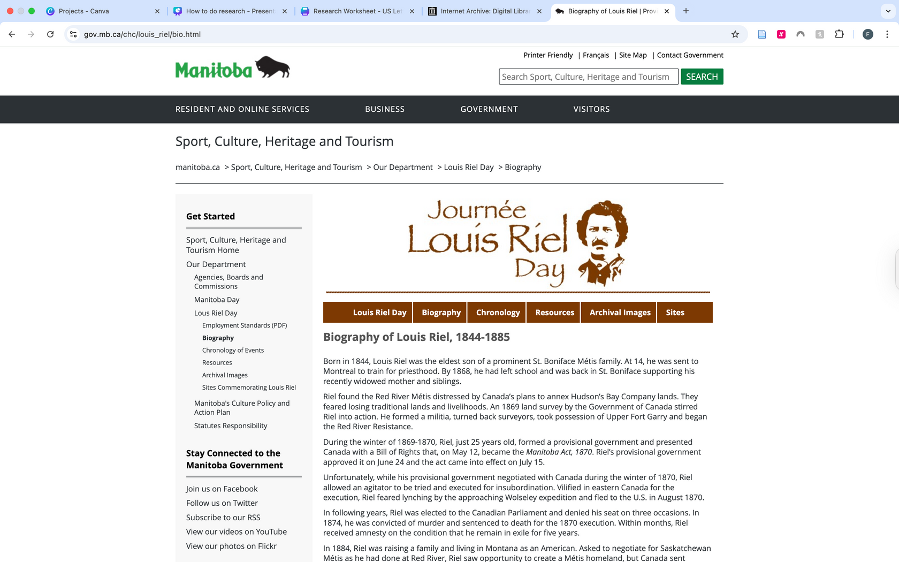
Now you’re ready to do some research!
10
Location of the source (website URL)
Author
How do I find this information?
No publication date
Source title
Notes:
So, how do you find all of this information I just listed?
For example, I want to do my project on Louis Riel. I searched “Louis Riel” on Google, and I found a source from the Government of Manitoba website.
The page has the source title, the author is the Government of Manitoba, the location of the source is the URL up at the top, and this source does not list a publication date.

Slide 4
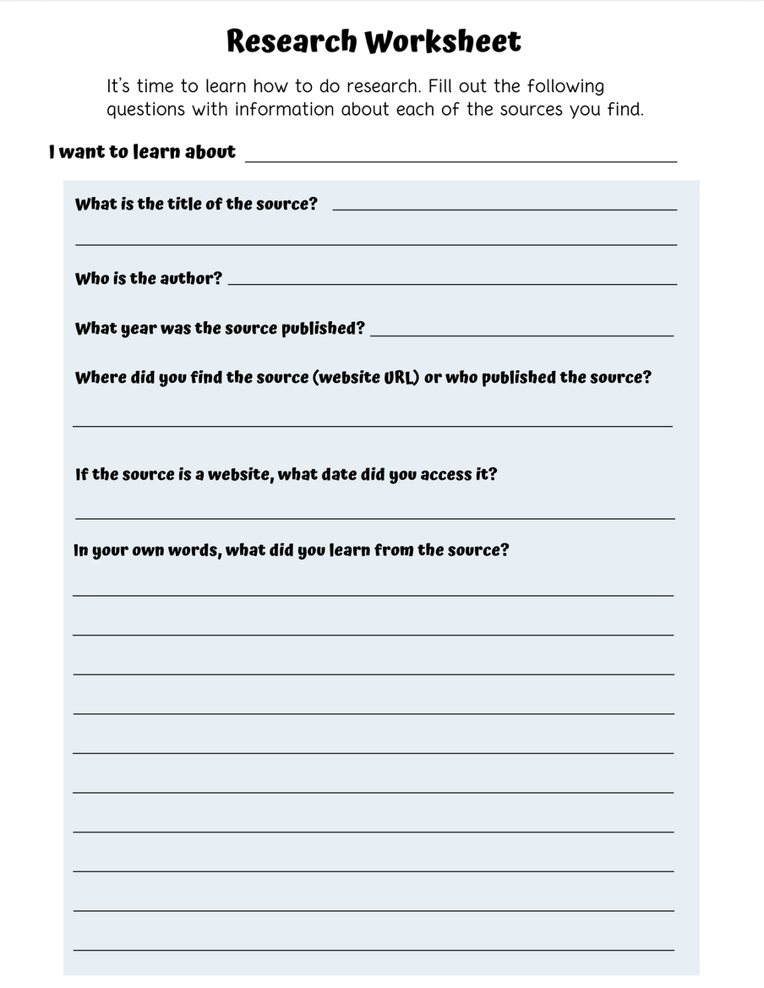
How to fill out the Research Worksheet
11
Louis Riel
Biography of Louis Riel, 1844-1885
Record all important information on the source
Government of Manitoba
No date
www.gov.mb.ca/chc/louis_riel/bio.html
July 15, 2025
Louis Riel was born in St. Boniface, Manitoba, in 1844.
He was worried about losing his traditional Métis homeland to the Canadian government, so he started a militia and formed the Red River Resistance. Louis Riel’s provisional government created the Manitoba Act of 1870.
Notes:
Use the Research Worksheet provided on the Heritage Fairs website to help practice recording important information on your sources.
So, for starters, I want to learn about Louis Riel. What is the title of the source I found? Biography of Louis Riel, 1844 – 1885. Who is the author? The Government of Manitoba. Where did you find the source, in this case it is a website, so you provide the URL.
This source is a website, so we need to record the date we accessed the information.
Finally, at the bottom of the page, write down what you learned from the source, in your own words.

Slide 5
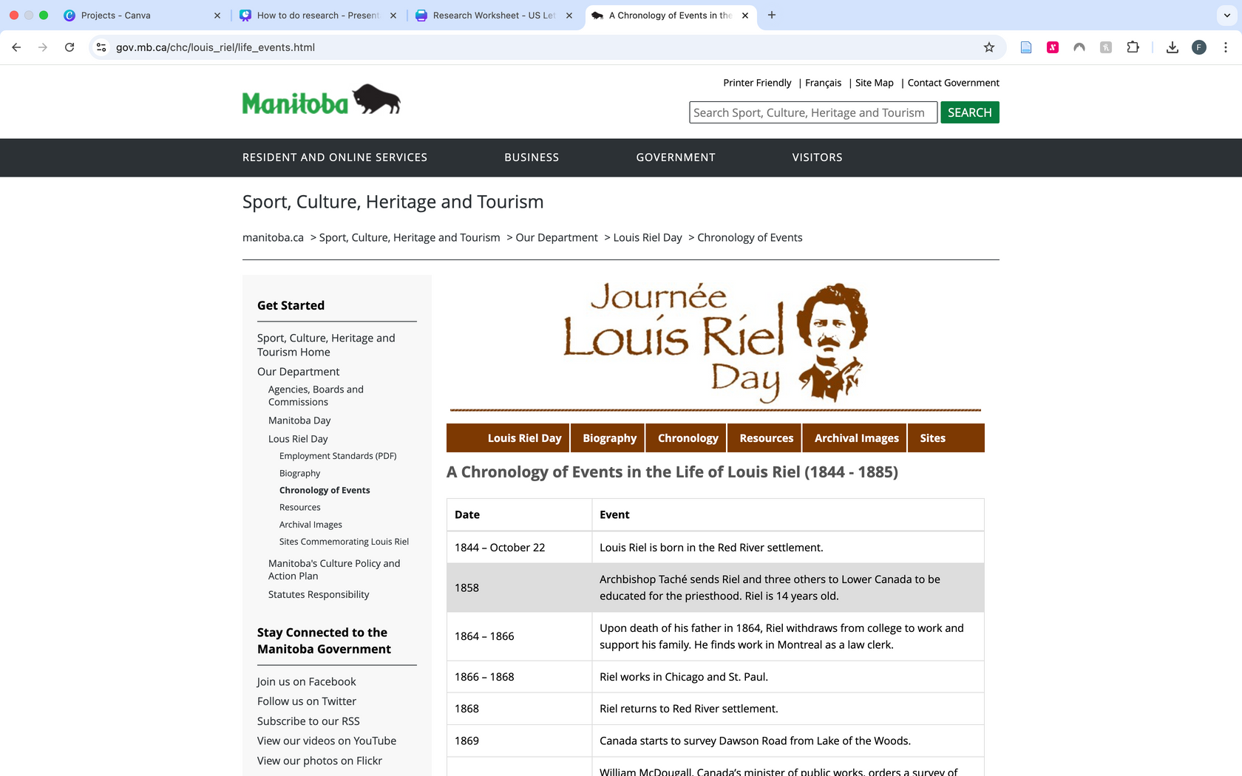
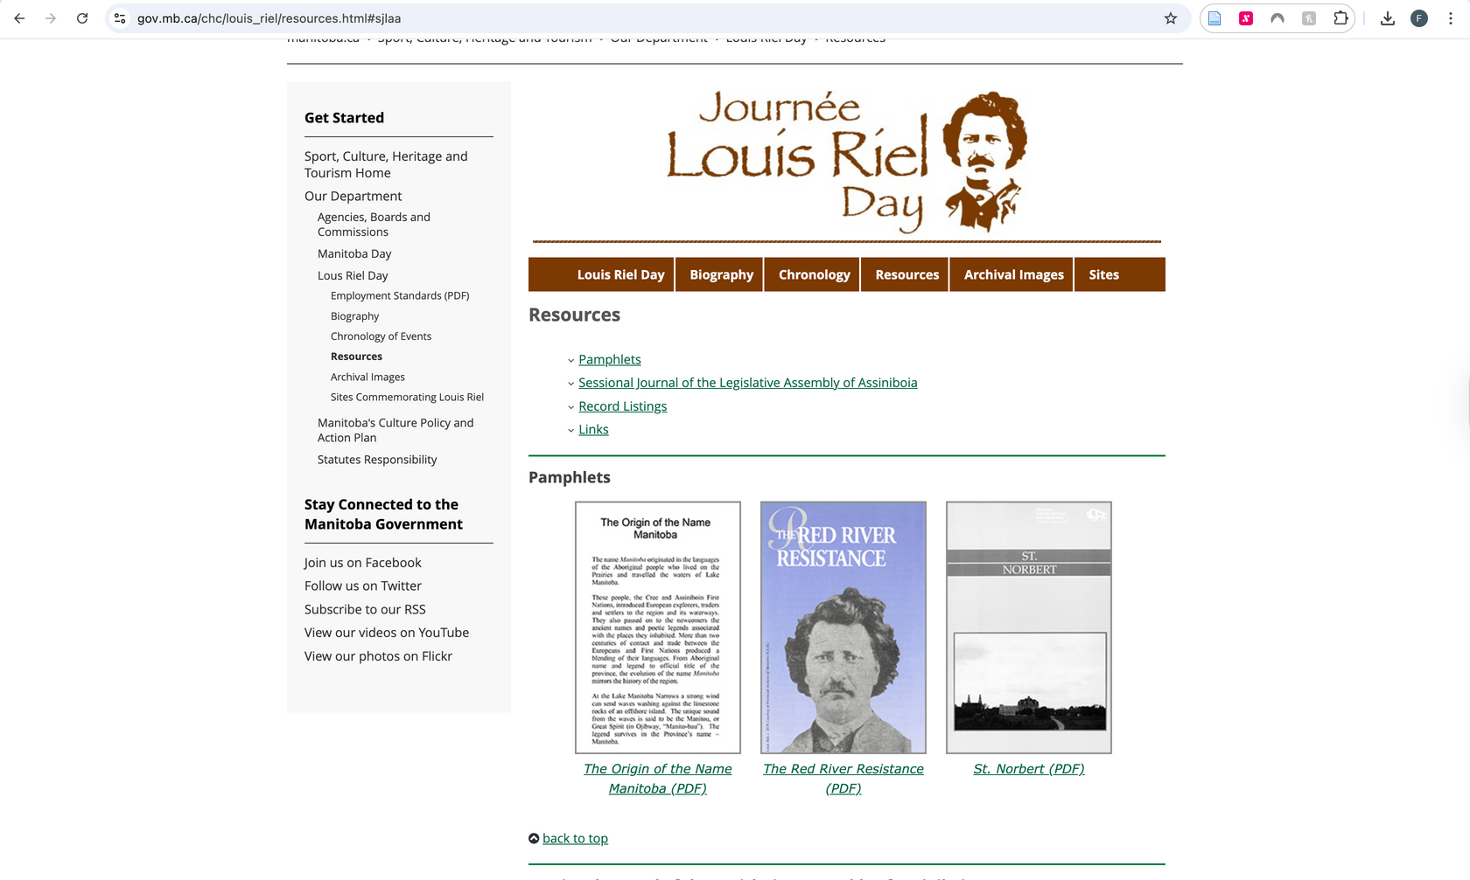
One source will probably not give you enough information
12
Keep searching for more sources to find new information
Notes:
To learn more about your topic search for more sources. In this case the Government of Manitoba website has additional tabs with links to more resources, so I could go to one of those next.

Slide 6
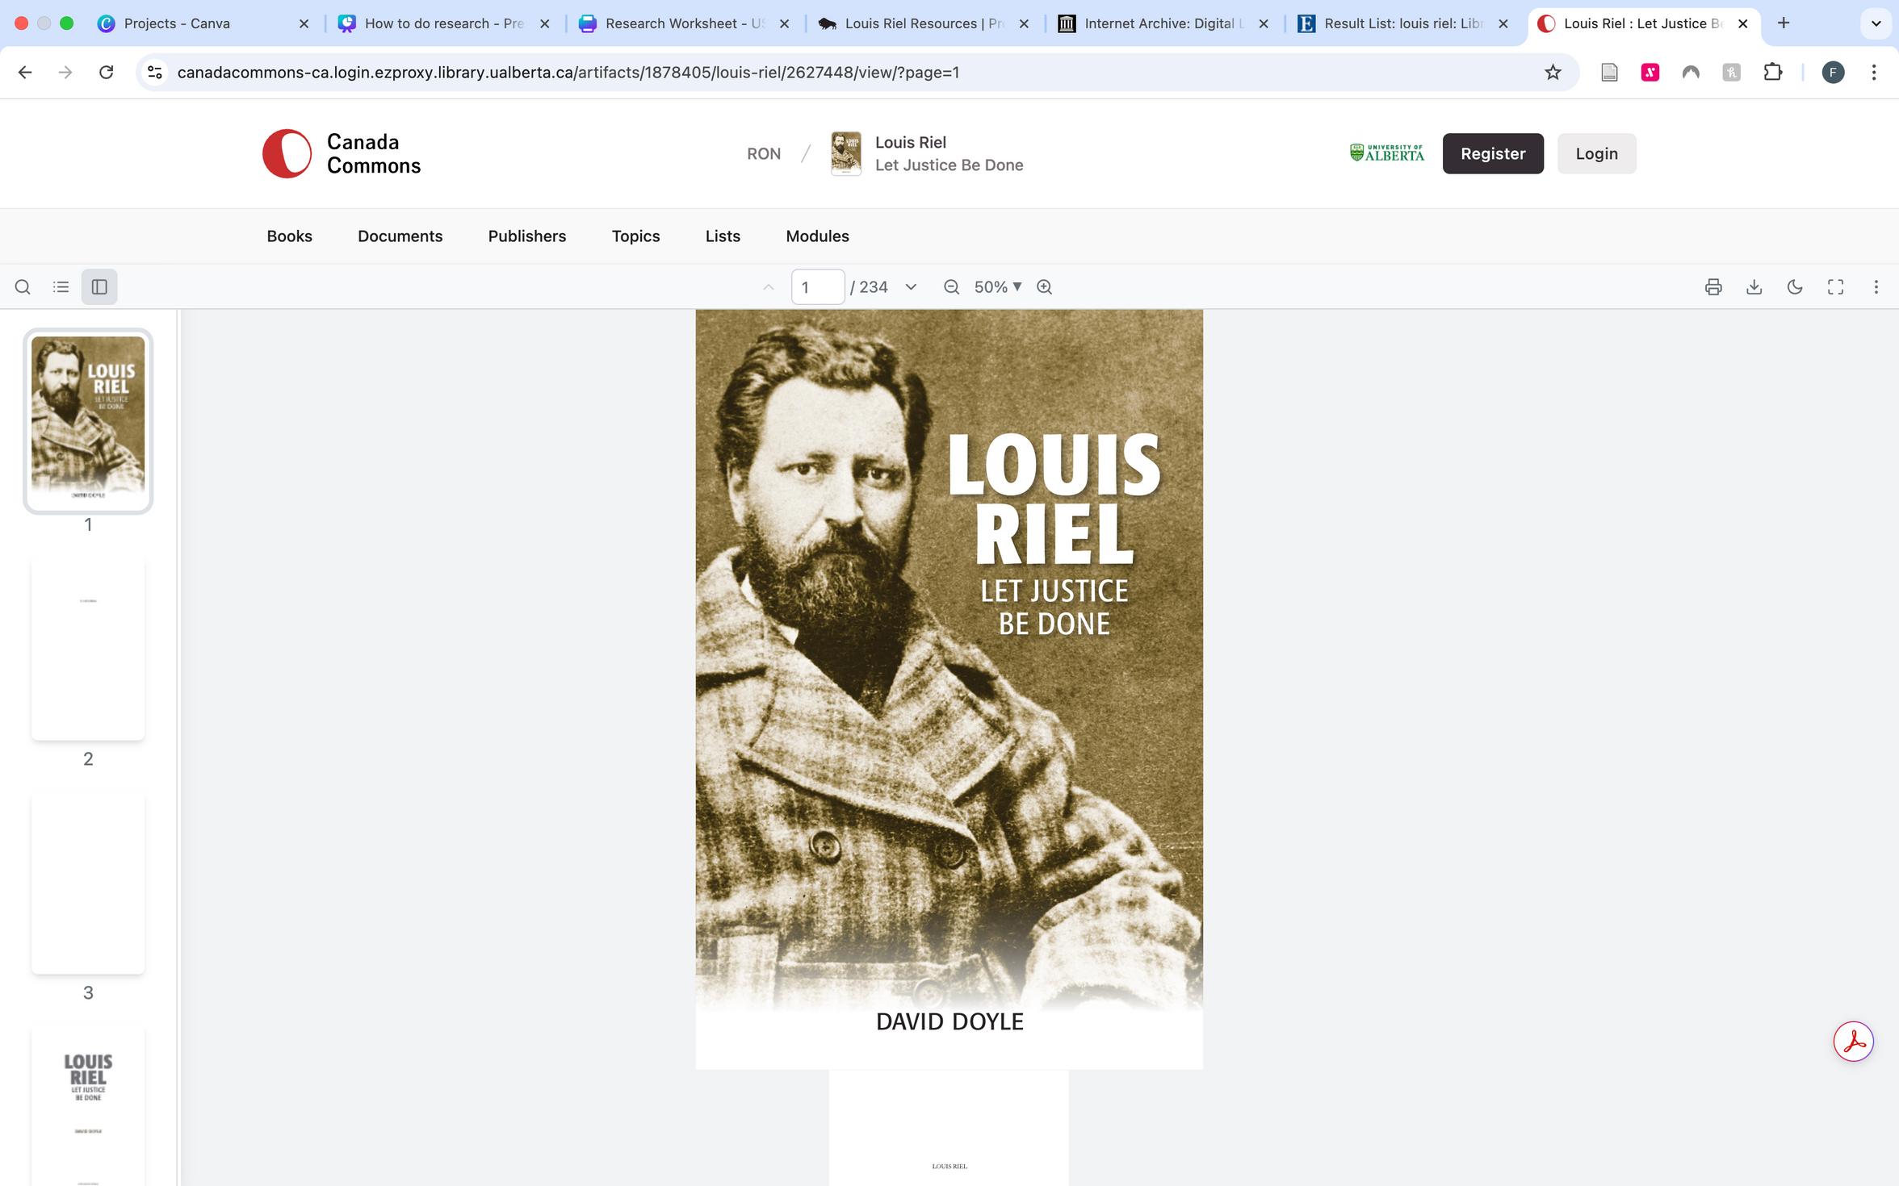
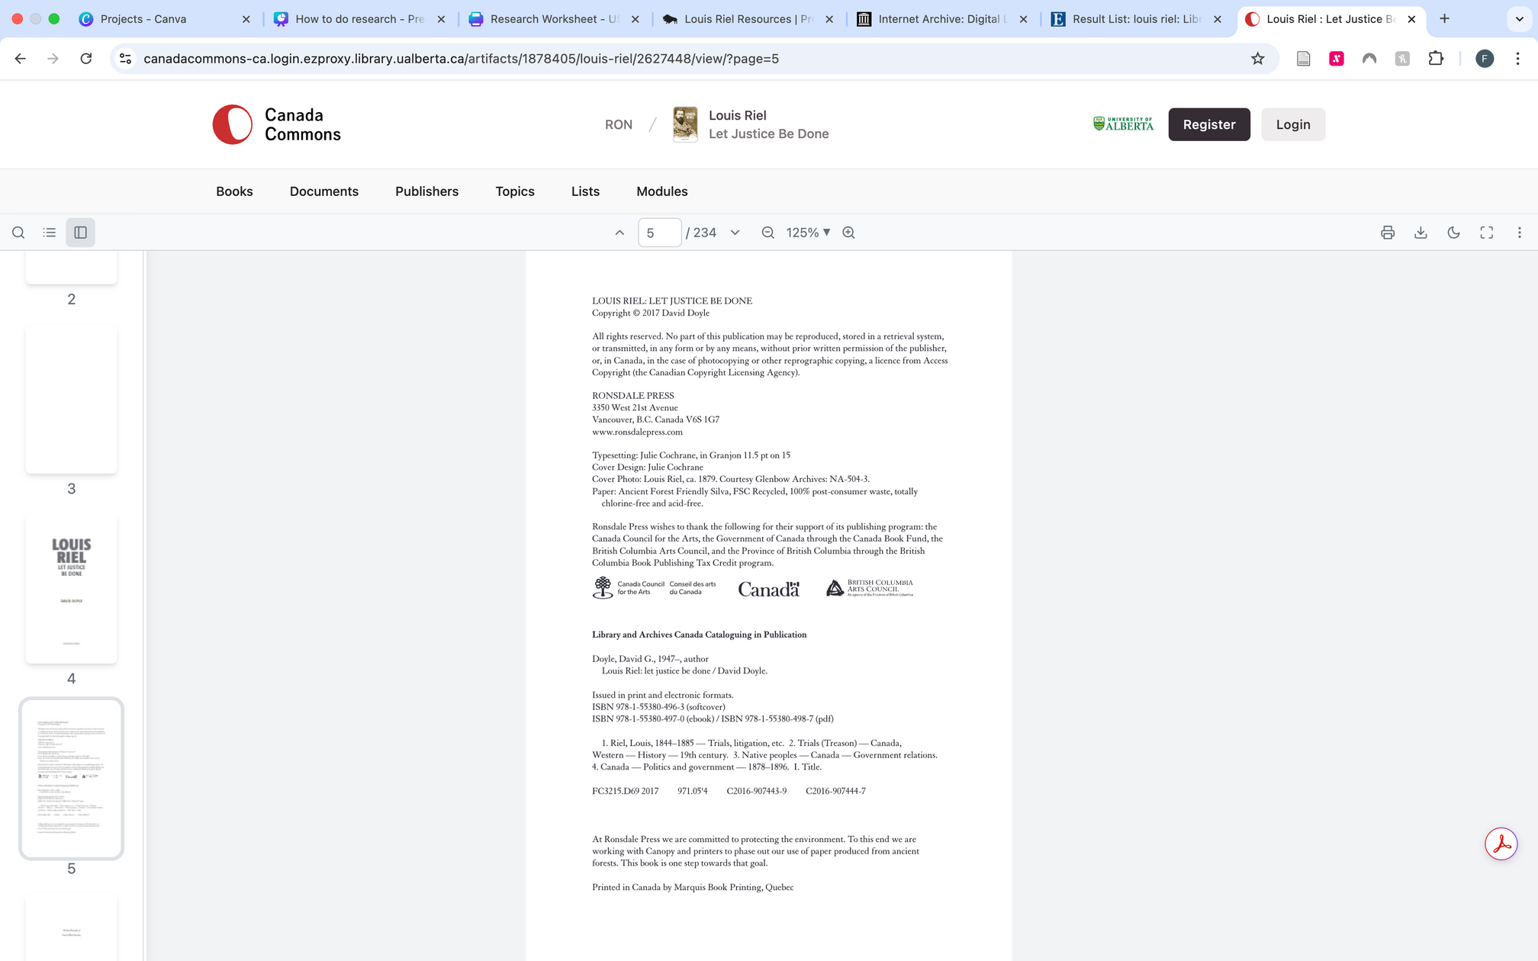
Other types of sources
13
Year it was published
Publisher
Book Sources
Source title
Author
Book Cover
Copyright Page
Notes:
You can also look for books on your topic. Some of these can be found in your library, or digital versions may be found online. One of the books I found listed on my library’s website was Louis Riel, Let Justice Be Done by David Doyle. For book sources, all of the information you need to take note of about the source for your worksheet can be found on the cover of the book and on the copyright page (which is usually a few pages in).
On the cover you will find the source title and the name of the author.
On the copyright page, you will find the year that the book was published, who the publisher was and their location.

Slide 7
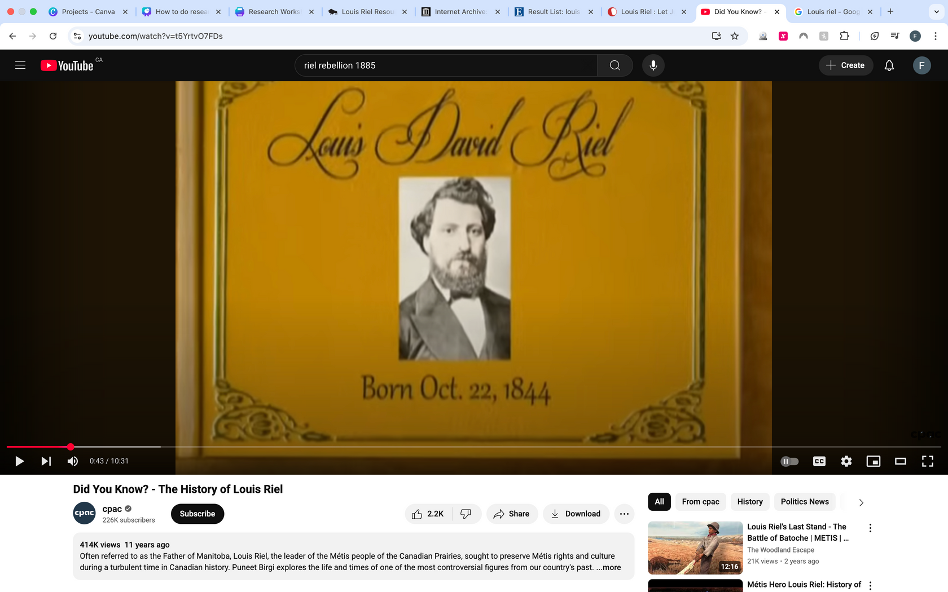
Other types of sources
14
Source location (URL)
Videos
Source title
Author
When it was published
Notes:
Videos from trusted sources may also include good information. If you are unsure if a video is from a channel that is reliable, make sure to ask your teacher first.
For a youtube video, you will find the source title, author, and publication year under the video. Sometimes additional authors are listed in the description of the video. The source location is the URL at the top.

Slide 8
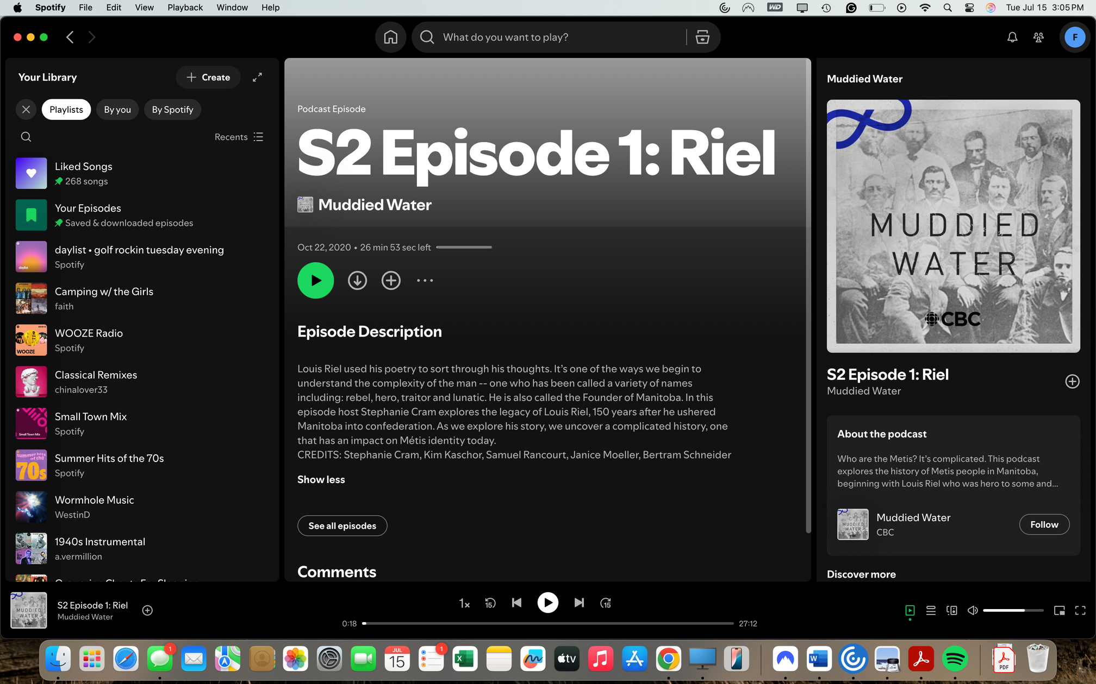
Other types of sources
15
Source title
Podcasts
When it was published
Authors
When it was published
Who published the source
Notes:
Podcasts from trusted sources are also useful. These could be from experts from a particular field, or from news sources like CBC. If you are unsure about if the source is trustworthy, look at the description of the podcast, or just look at podcasts from sources you know that are trustworthy. Always check with your teacher if you are unsure.
For this podcast episode on Louis Riel I found on spotify, the source title (or episode title) is at the top of the page, and the title of the podcast is found below it. Below that, you can find the publication date. At the end of the episode description, the credits are listed with the names of the authors.
The publisher of the podcast is a bit harder to find, on the right hand side, the publisher, CBC is listed under the podcast title.

Slide 9
After gathering all the research for your project, you can build a reference list
16
Your reference list shows where you got your information from
Reference List
cpac. 2014. Did You Know? The History of Louis Riel. https://www.youtube.com/watch?v=t5YrtvO7FDs. Accessed on July 15, 2025.
Cram, Stephanie, Kim Kaschor, Samuel Rancourt, Janice Moeller, Bertram Schneider. 2020. S2 Episode 1: Riel, Muddied Water. CBC. https://open.spotify.com/episode/4jFUhinCzXwfoLuwEdZfqe. Accessed on July 15, 2025.
Doyle, David. 2017. Louis Riel: Let Justice Be Done. Ronsdale Press, Vancouver.
Government of Manitoba. n.d. Biography of Louis Riel, 1844-1885. www.gov.mb.ca/chc/louis_riel/bio.html. Accessed on July 15, 2025.
Author’s last name first
Publisher location
*n.d. is an abbreviation for no date
Notes:
Your reference list shows where you got your information from.
On the slide you will find an example of what a reference list can look like using the information we gathered from all of the source examples.
You list the author of the source first. Each of the references will be listed by alphabetical order based on the author’s name. If this is a person, you will put their last name first. If the source is made by multiple people you have to list all of the authors, but only the first person you list will have their last name first, like the second reference in the example. After the author’s name, we put down the year the source was published, then the title of the source, followed by the publisher information (who published the source). If you accessed the source online, you will also include the website URL alongside the date you accessed the source. If the source is a book, instead of a URL and access date, you will just include the name of the publisher and the city where the publisher is located.
If there is no date listed like on the Government of Manitoba website we used for one of our sources, you can put n.d. in place of the date.

Slide 10
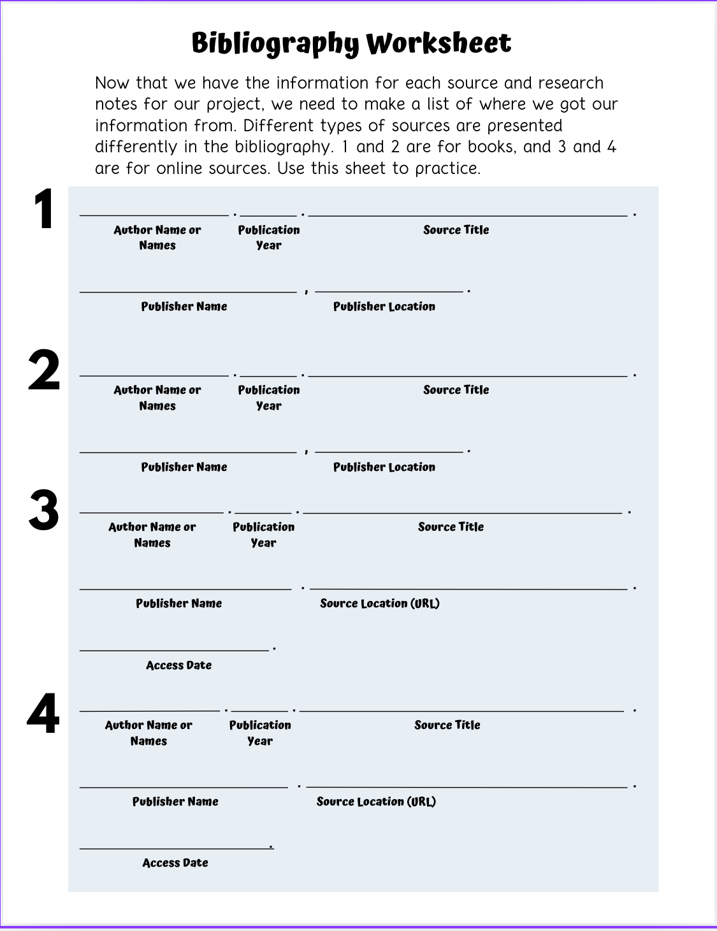
Use the References Worksheet to try it out yourself!
17
Doyle, David
2017
Louis Riel: Let Justice Be Done
When we learn new information and use it in our projects, we must give credit to the author.
Ronsdale Press
Vancouver
Government of Manitoba
n.d.
Biography of Louis Riel, 1844-1885
www.gov.mb.ca/chc/louis_riel/bio.html.
Accessed on July 15, 2025
Notes:
When we learn new information and use it in our projects we have to give credit to the author.
On the screen you will find an example of how to fill out the reference worksheet. Go through and find sources for the topic you have chosen, and practice finding the reference information and fill out the blanks on the worksheet. Numbers one and two on the worksheet are for book sources, and three and four are for website sources. Continue practicing with different sources so you will know how to make a reference list for your Heritage Fair project.

Slide 11
Make sure to check out the Heritage Fairs website for more project tips, resources, and lessons!

